Slide 1
Customer Data Managment
Team:
Mohamed Sameh (leader)
Rawan Amr
Esraa Osama
Mohamed Ibrahim
Shahd Waleed
Ali Sherif

Slide 2
Contents of this template
Week 1 | Data Managment & SQL Database Setup
Week 2 | Data Warehousing & Python Programming
Week 3 | Data Science & Model Building
Week 4 | Using Predictive Model & Final presentation

Slide 3
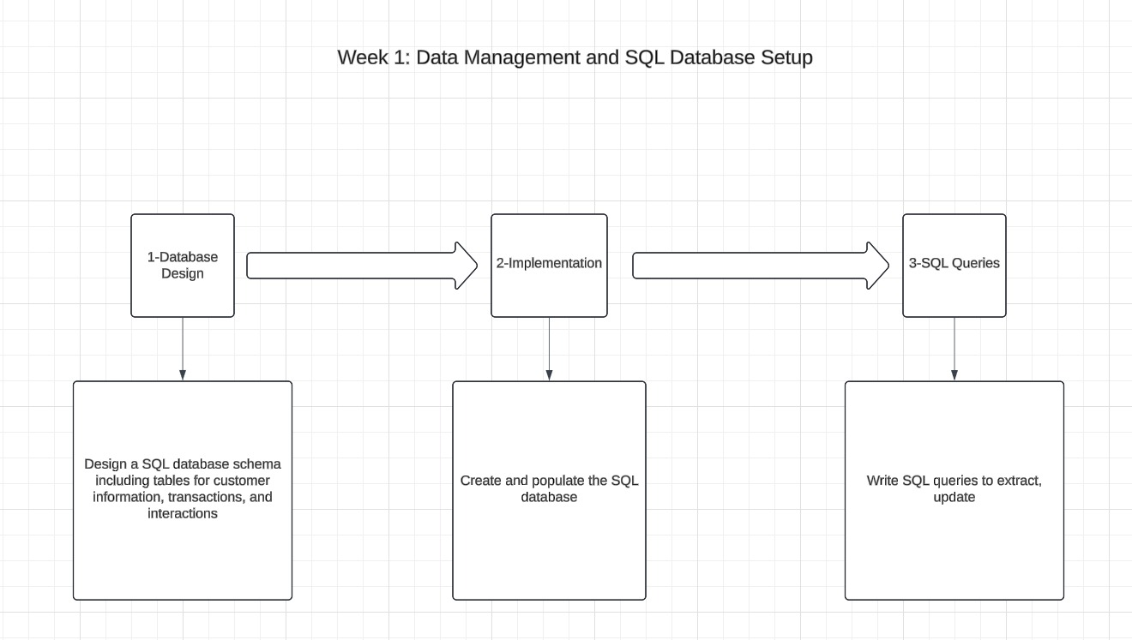
Week1
Data Managment & SQL Database Setup

Slide 4
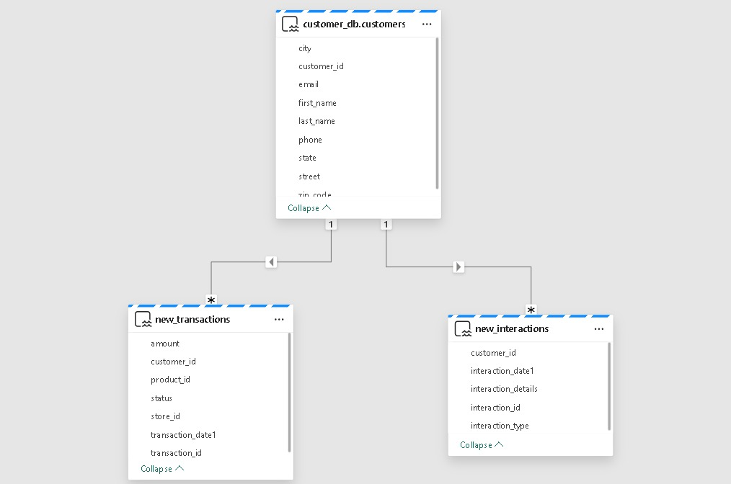
Here is the schemas of week 1
Contains the tables of the customers info like shown

Slide 5
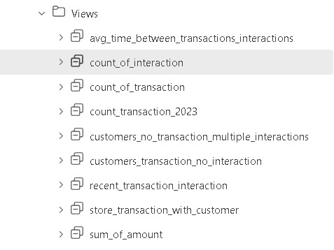
Views for week 1
Views to extract the data of the customers

Slide 6
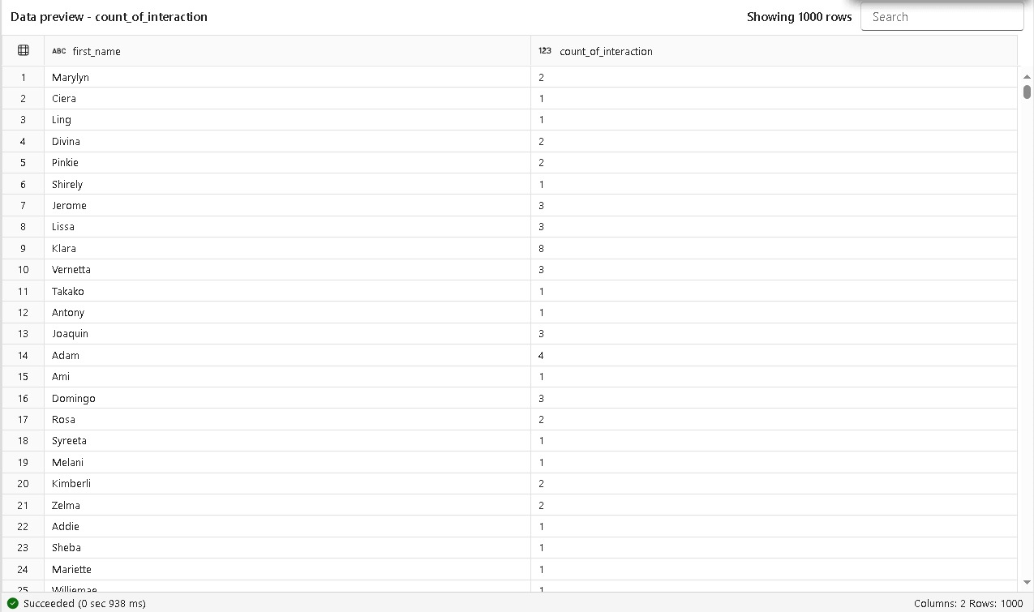
Views data preview

Slide 7
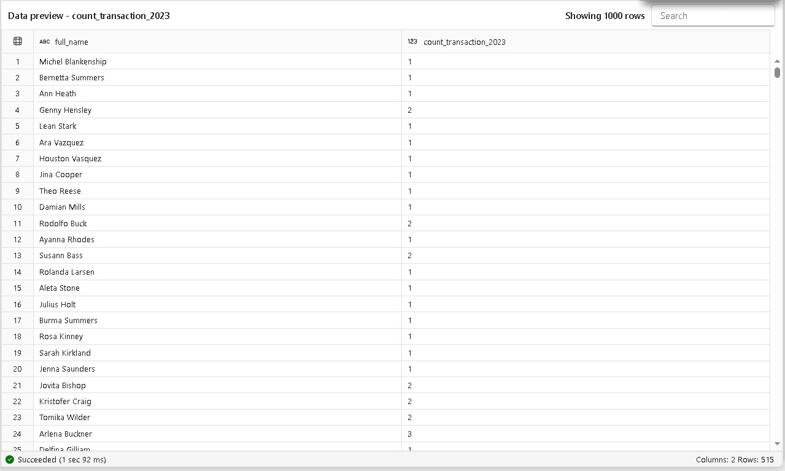
Views data preview

Slide 8
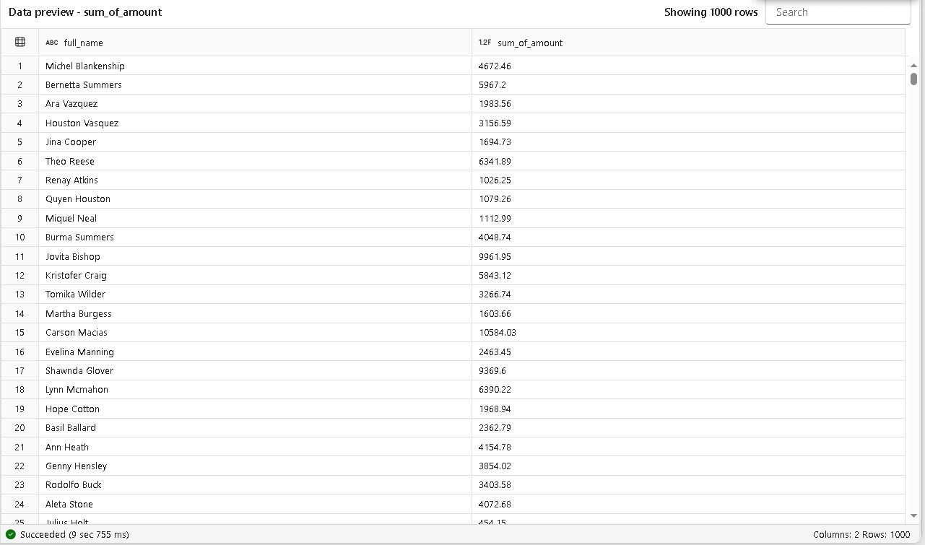
Views data preview

Slide 9
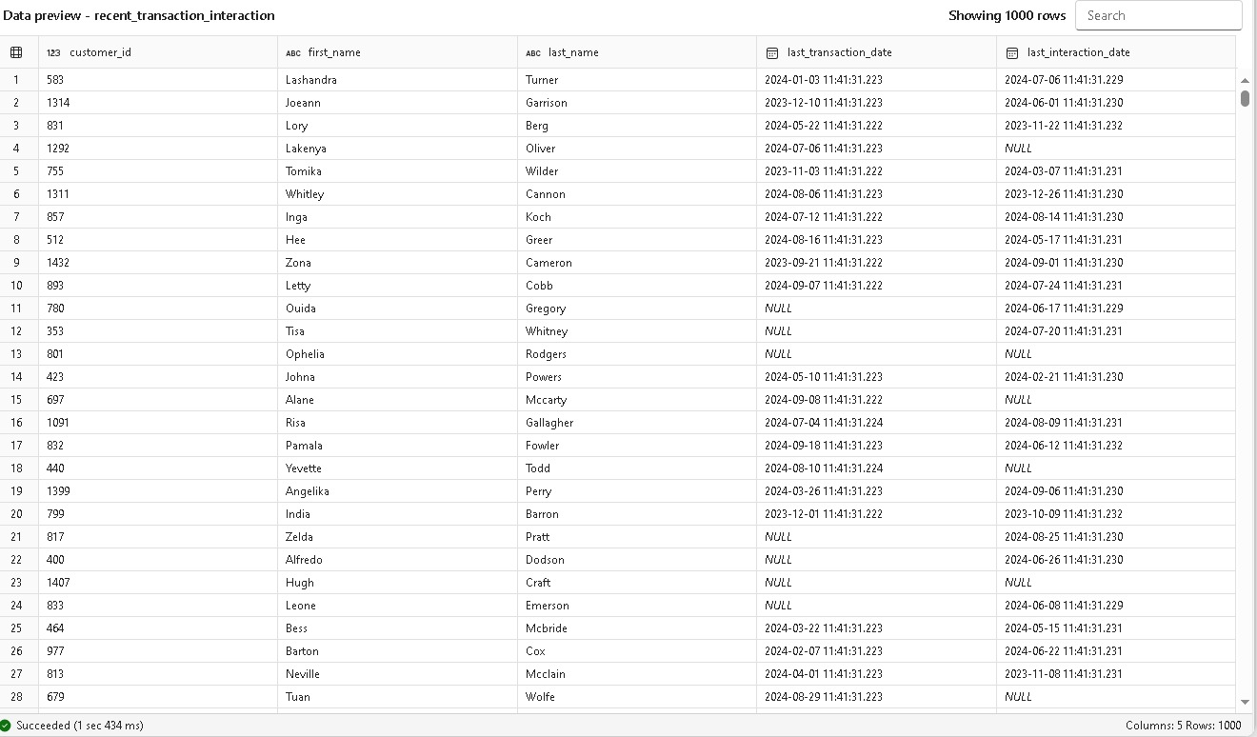
Views data preview

Slide 10
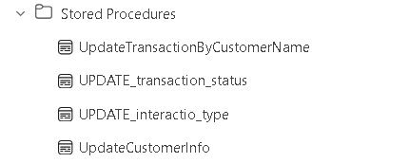
Stored procedures
Procedures to update customer data

Slide 11
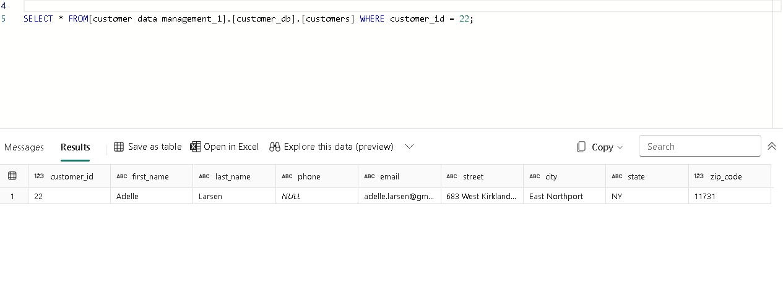
Example of using stored procedures
Before updating

Slide 12
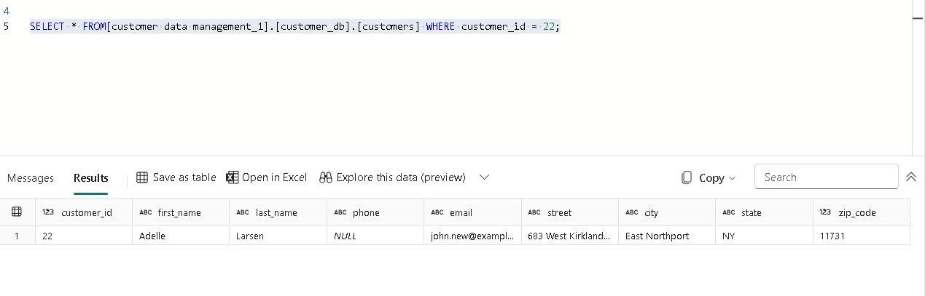
Example of using stored procedures
After applying the stored procedure

Slide 13
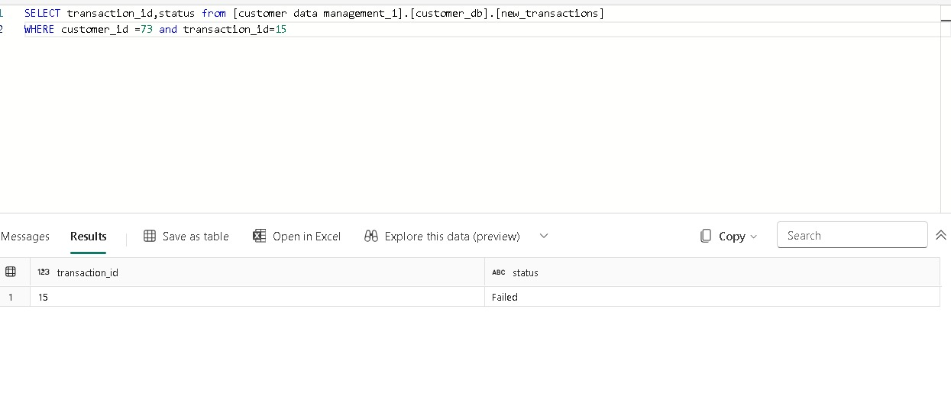
Example of using stored procedures
Before applying the stored procedure

Slide 14
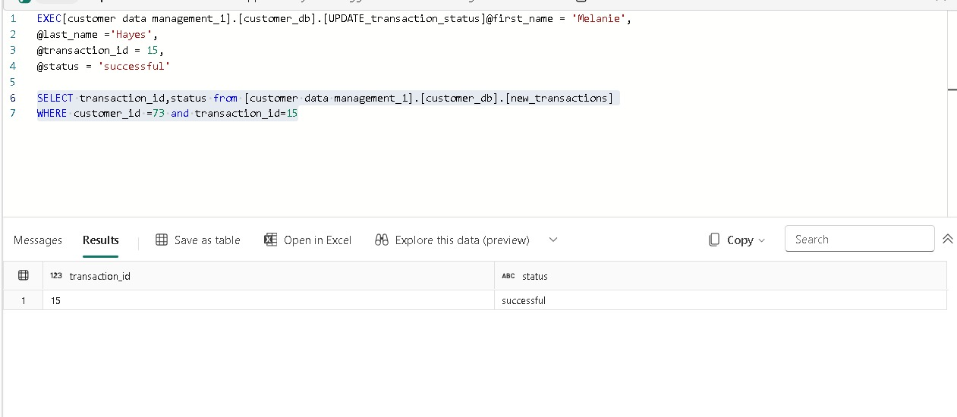
Example of using stored procedures
After applying the stored procedure

Slide 15
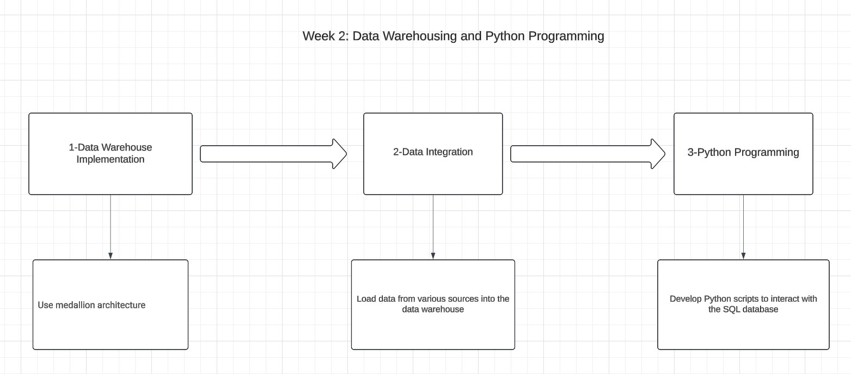

Slide 16
Firstly
Data Warehousing

Slide 17
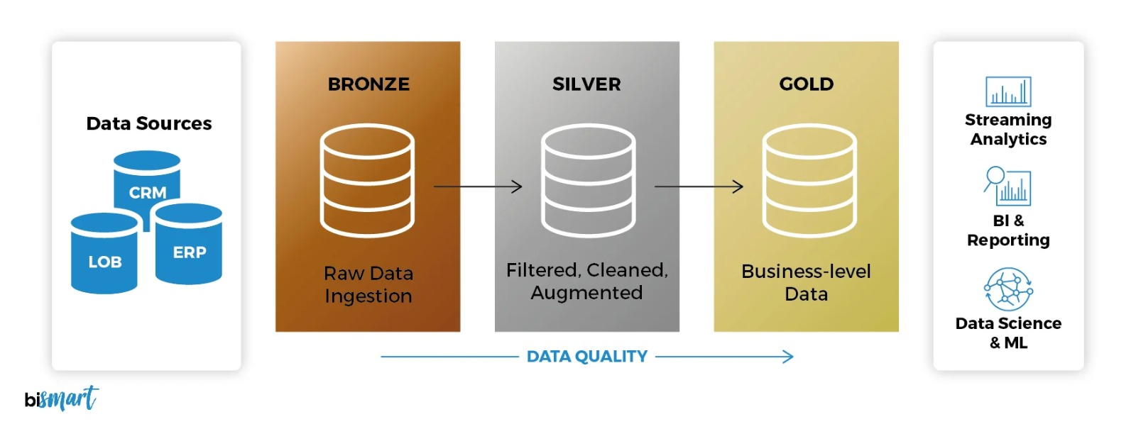
Medallion Architecture

Slide 18
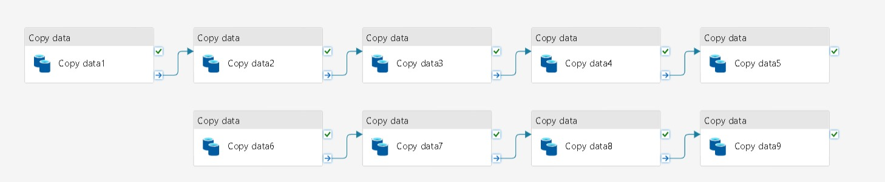
Bronze pipline
From the source to the bronze

Slide 19
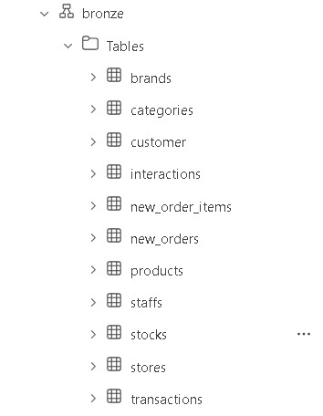
Bronze Schema
From the source to the bronze

Slide 20
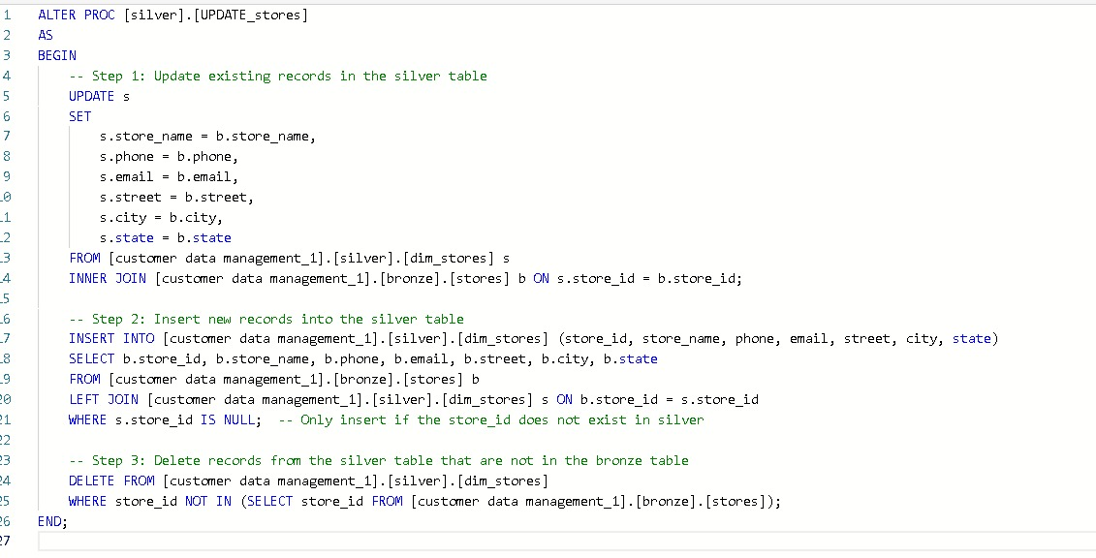
Bronze Schema
Transfer data from bronze schema to silver schema

Slide 21
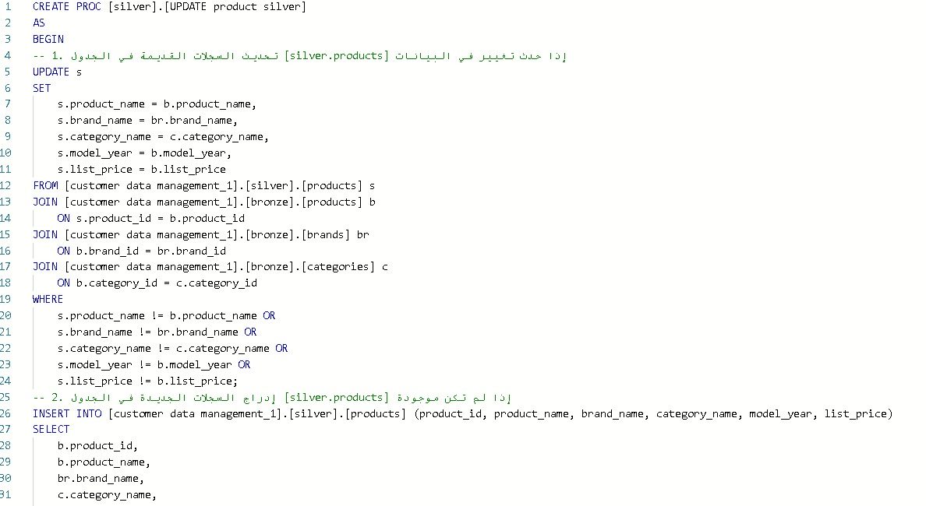
Bronze Schema
Transfer data from bronze schema to silver schema

Slide 22
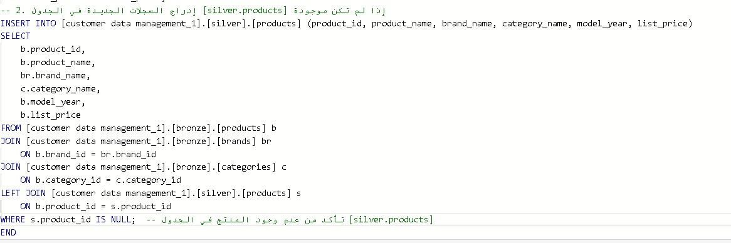
Bronze Schema
Denormalization & transfer data dim from bronze to silver

Slide 23
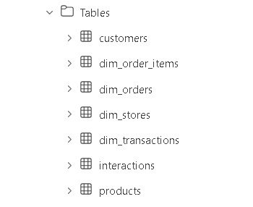
Silver Schema

Slide 24
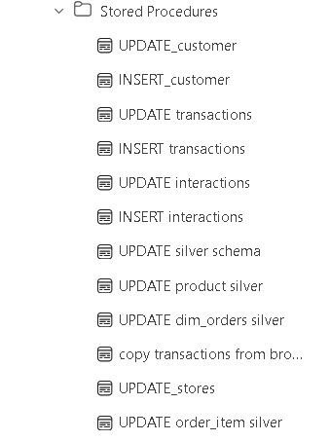
Stored procedures to transfer data to the Silver Schema
Silver Schema

Slide 25
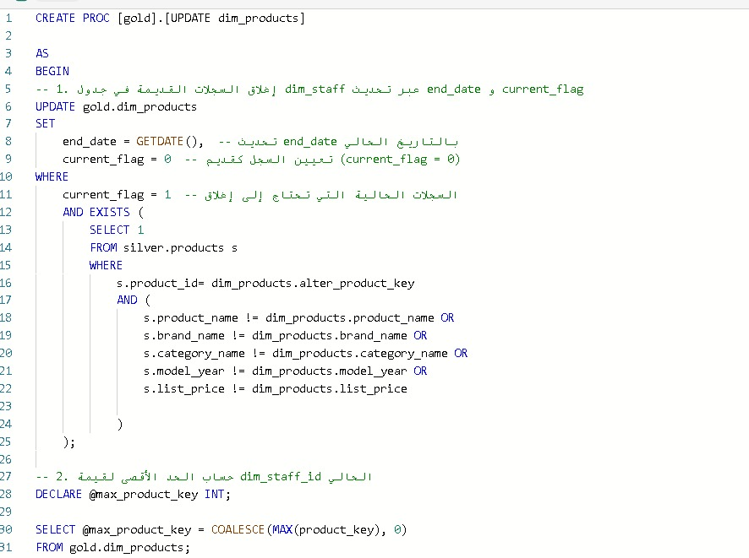
Example for transferring dim tables from silver to gold
Silver Schema

Slide 26
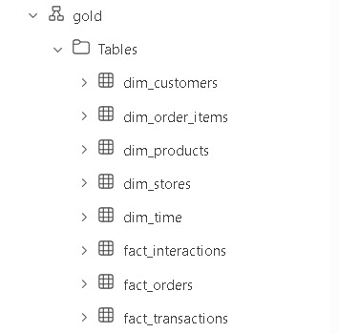
Gold Schema

Slide 27
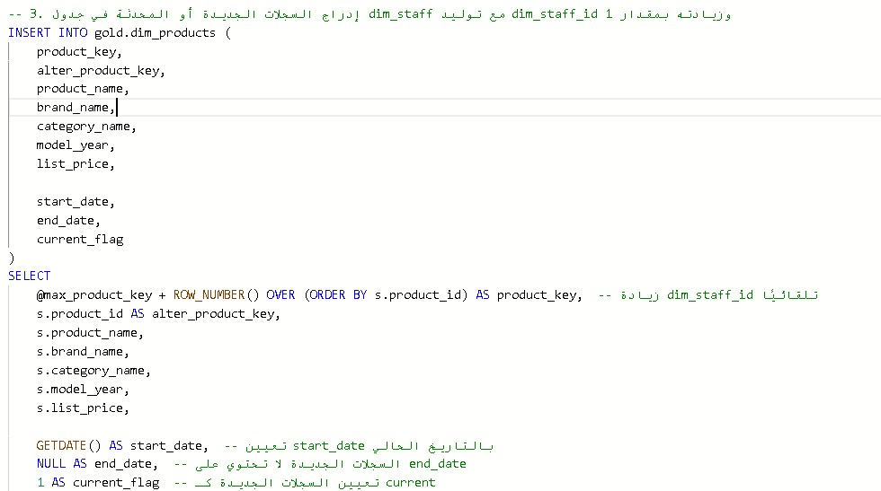
Gold Schema

Slide 28
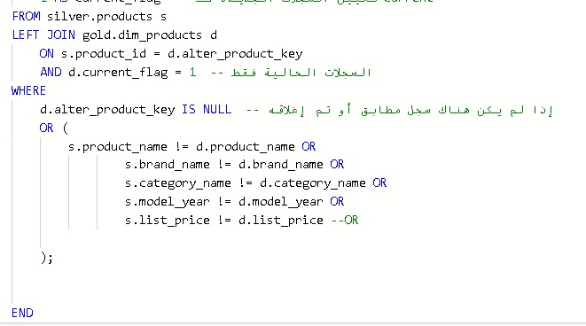
Gold Schema

Slide 29
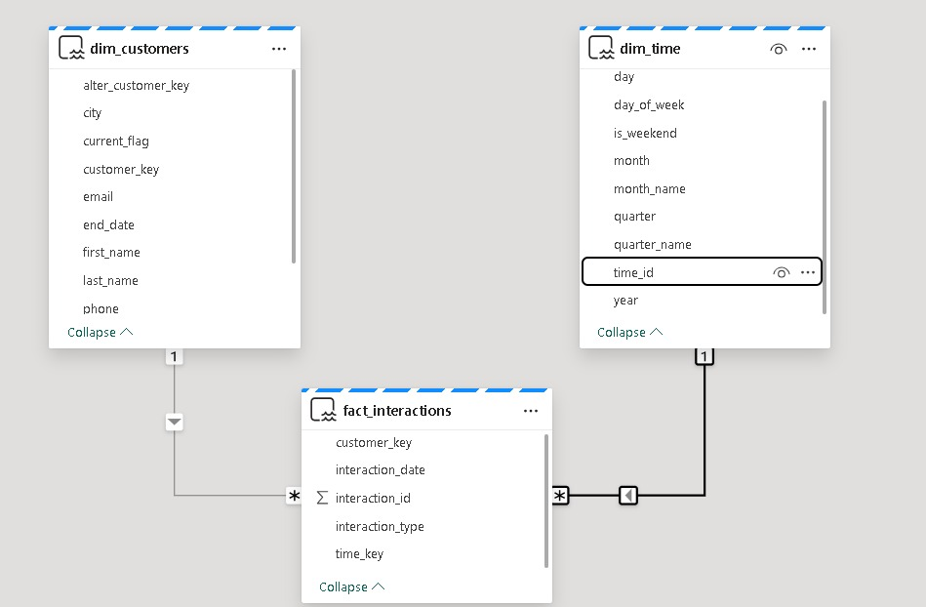
Gold Schema

Slide 30
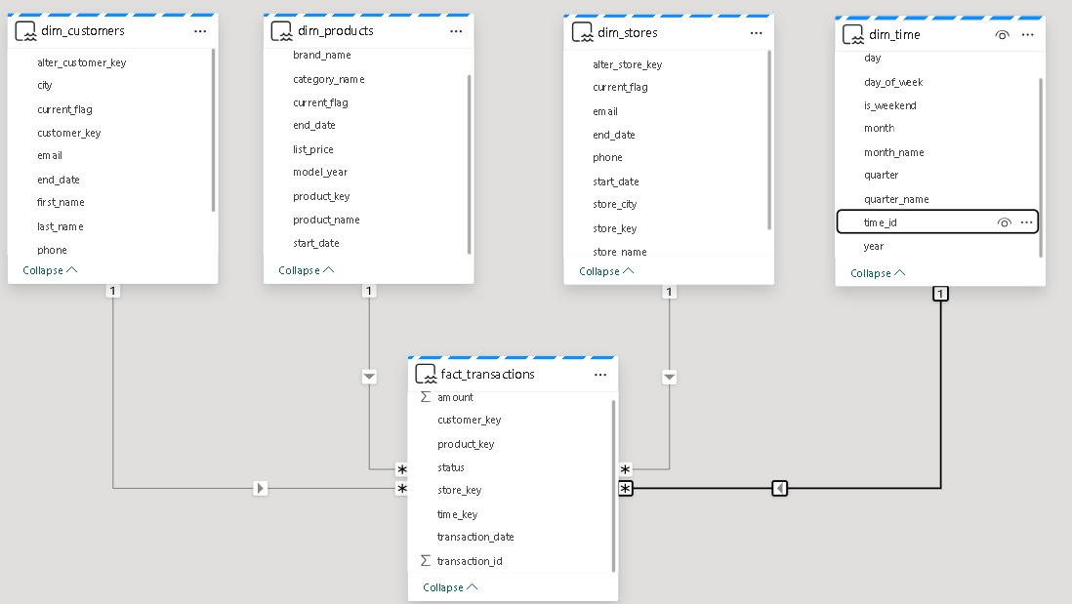
Gold Schema

Slide 31
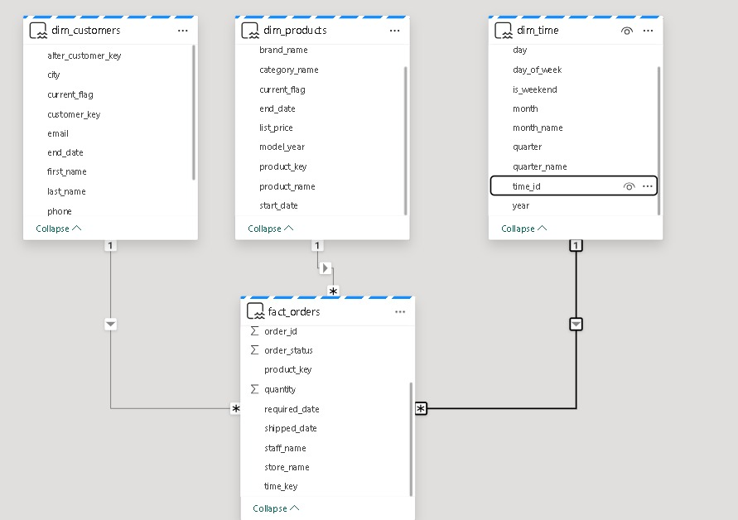
Gold Schema

Slide 32
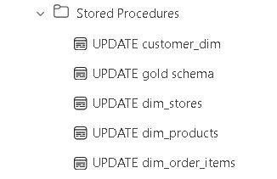
Stored procedures to update gold schema

Slide 33
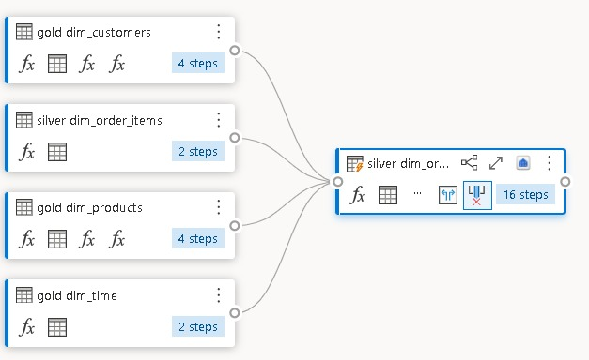
Fact table by dataflow gen 2

Slide 34
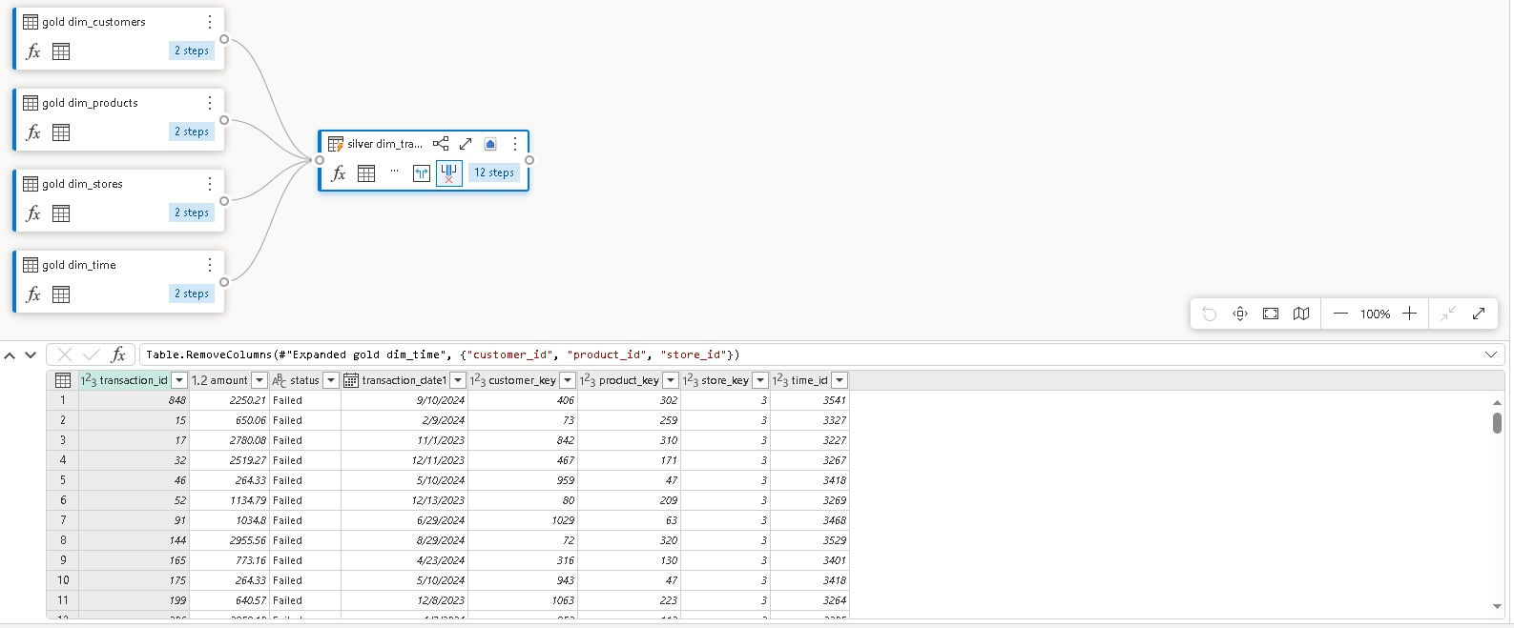
Transferring fact_transactions

Slide 35
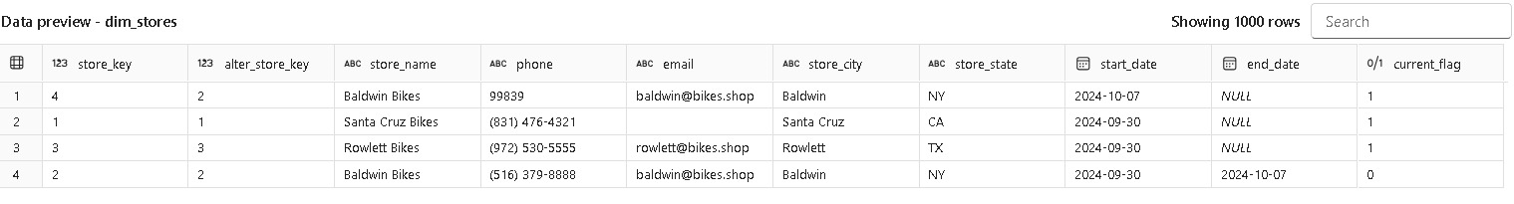
Data preview

Slide 36
secondly
Python programming

Slide 37
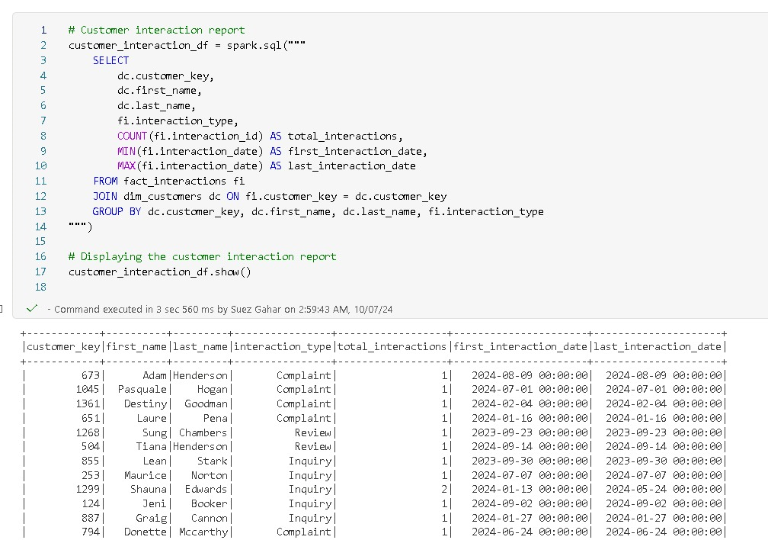
Python

Slide 38
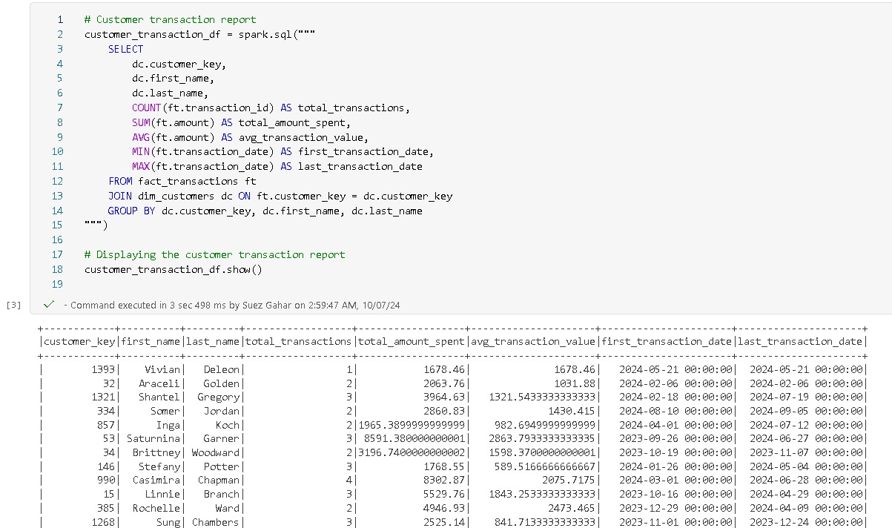
Python

Slide 39
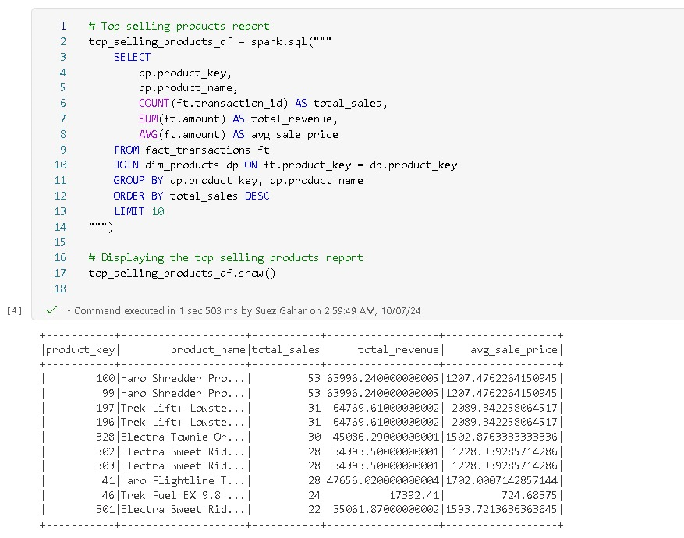
Python

Slide 40
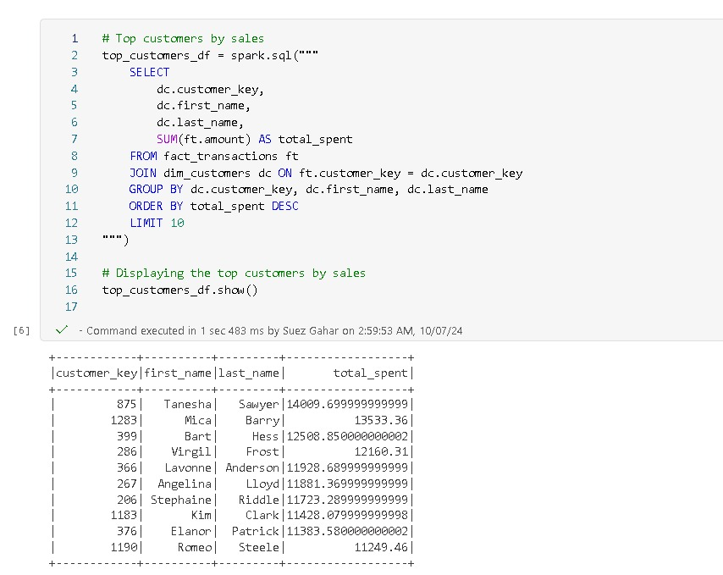
Python

Slide 41
Python

Slide 42
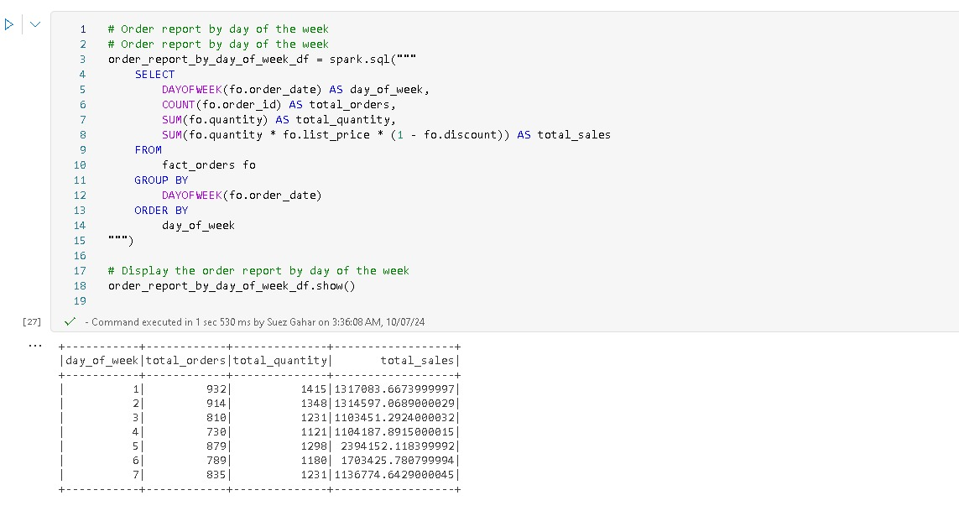
Python

Slide 43
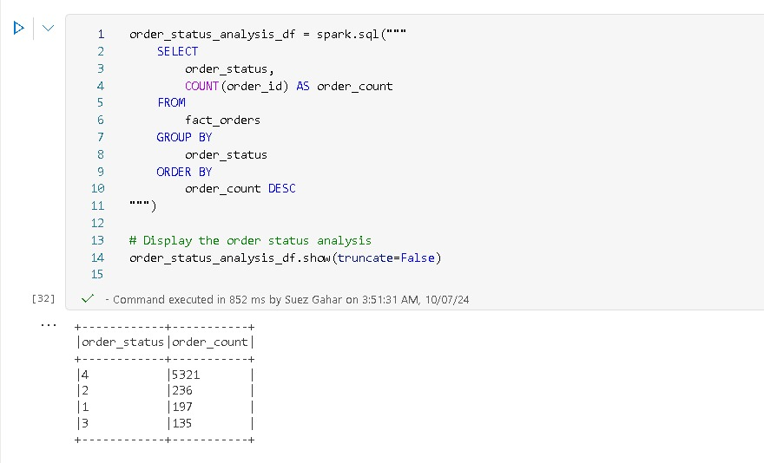
Python

Slide 44
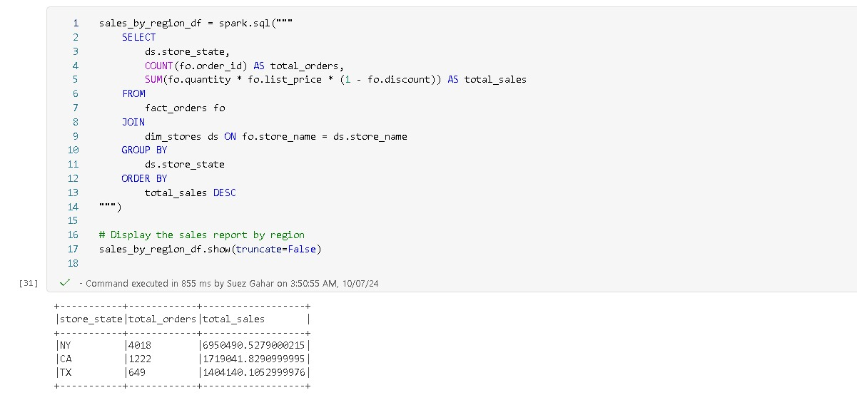
Python

Slide 45
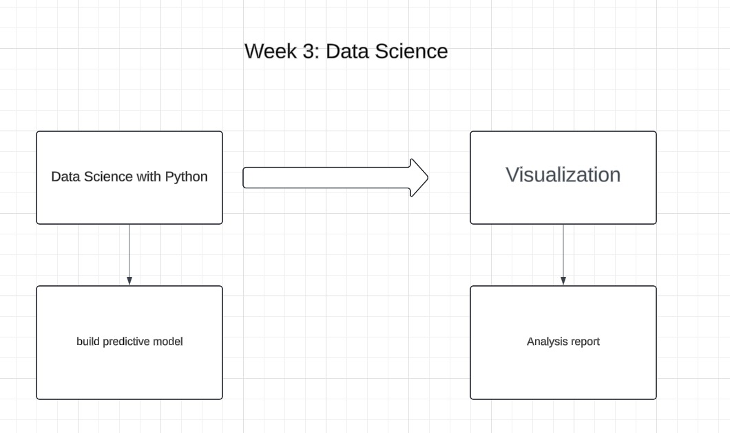

Slide 46
Firstly
Data
science

Slide 47
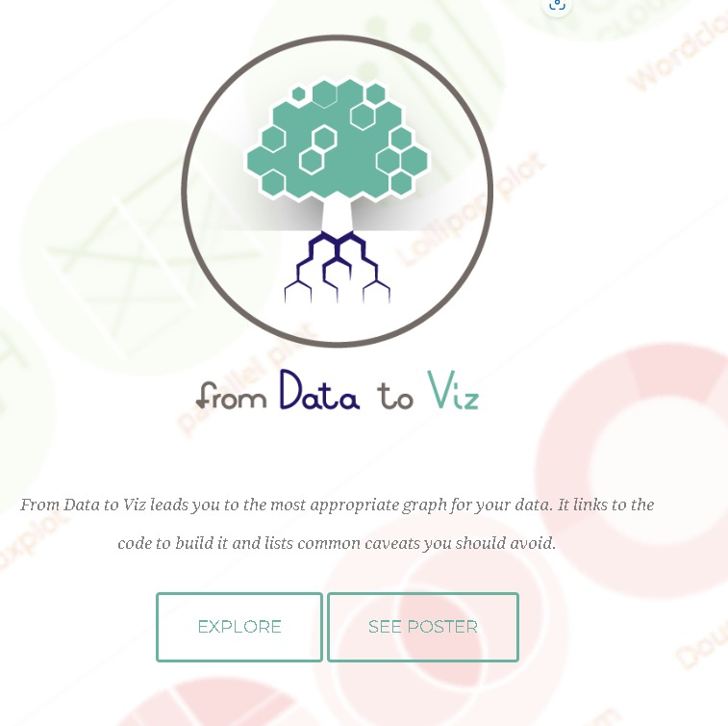
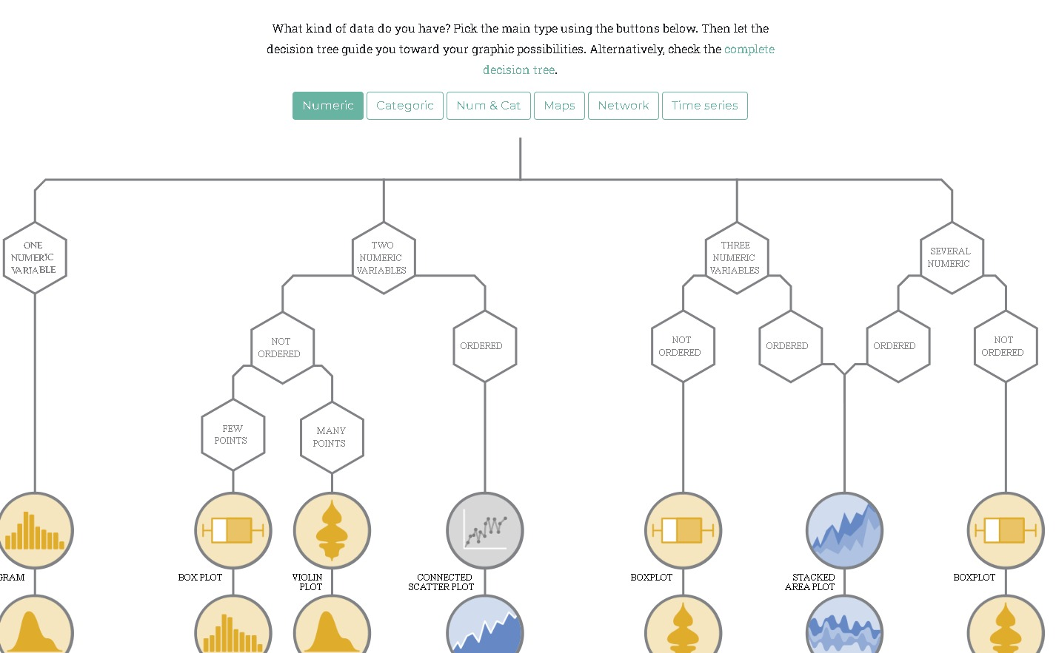
methods

Slide 48
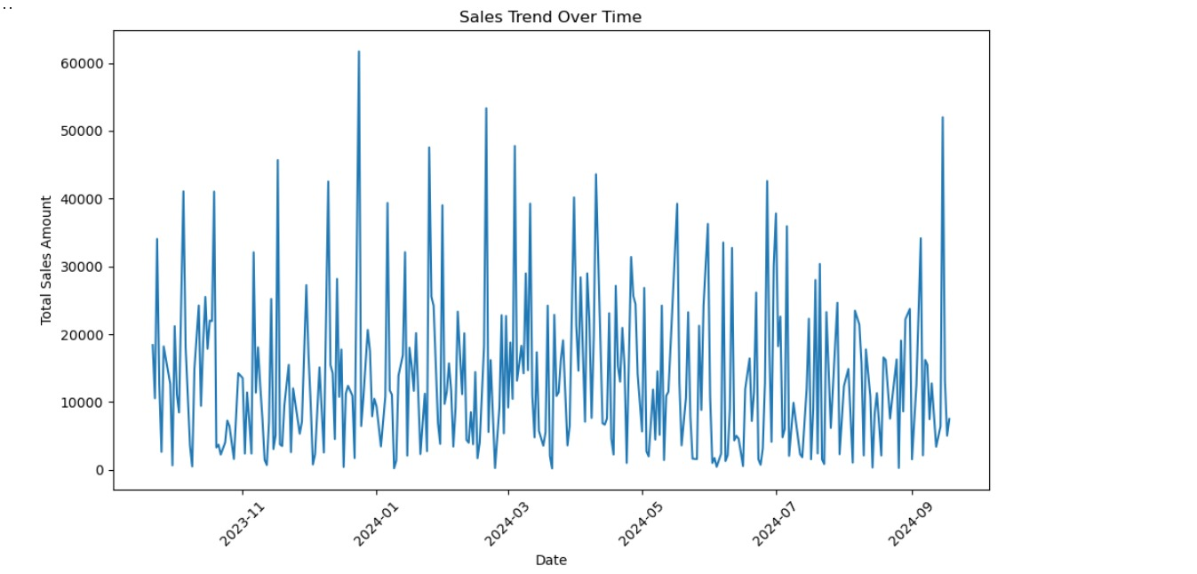
Examples for visualization

Slide 49
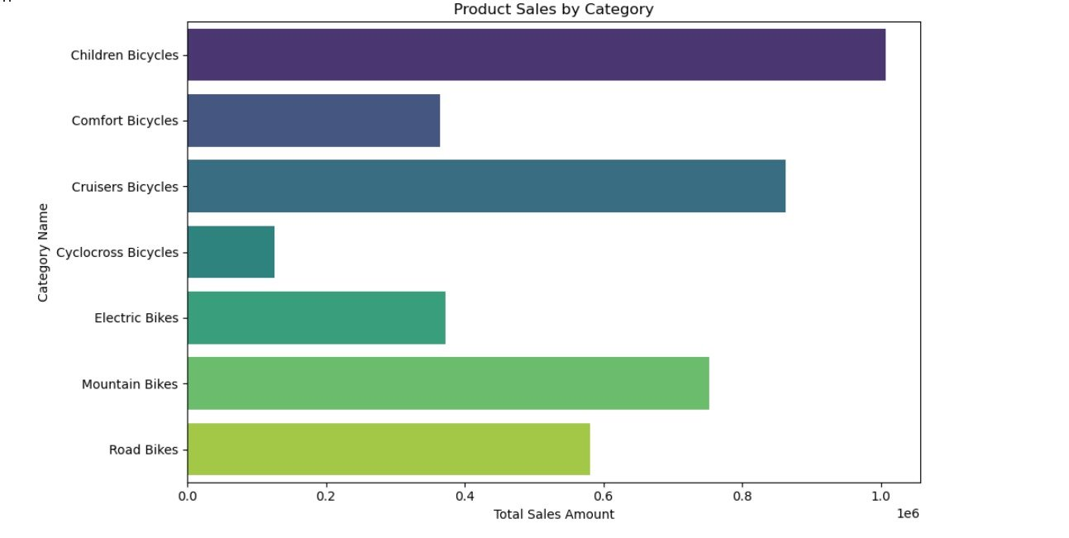
Examples for visualization

Slide 50
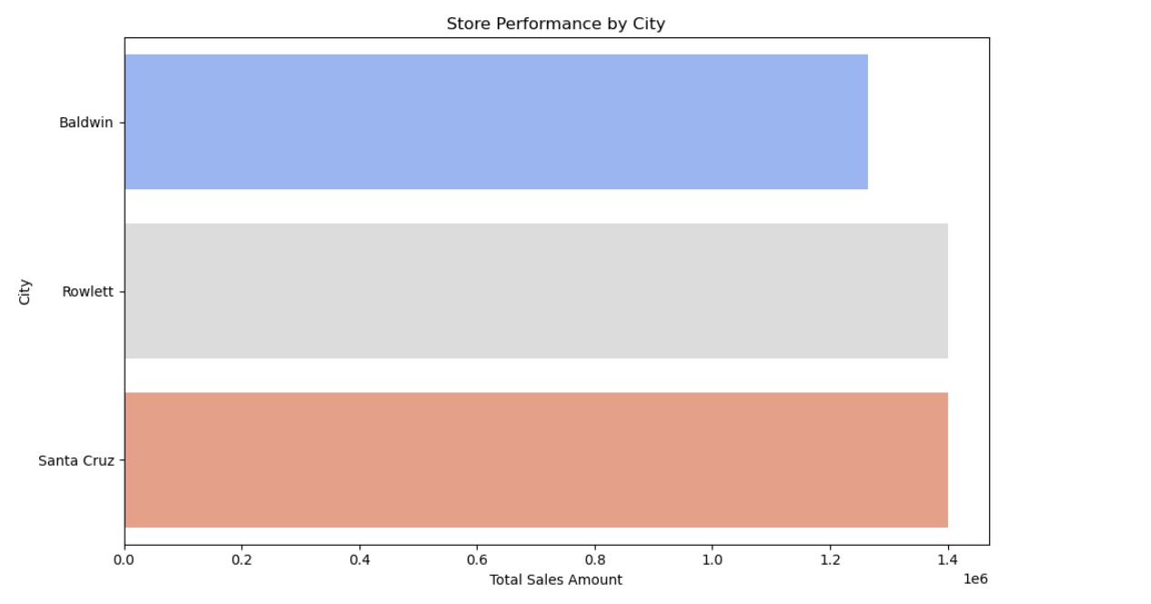
Examples for visualization

Slide 51
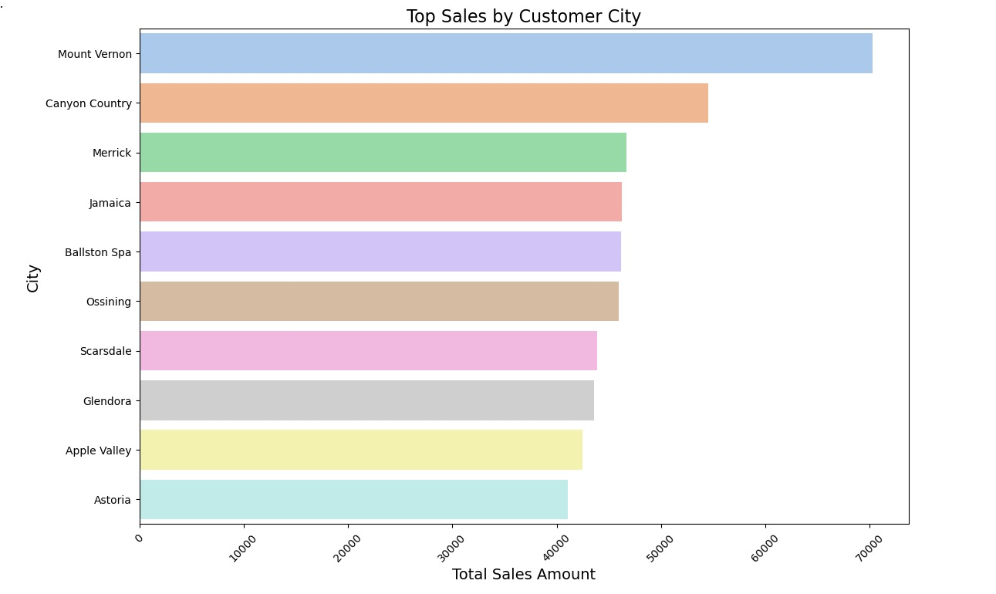
Examples for visualization

Slide 52
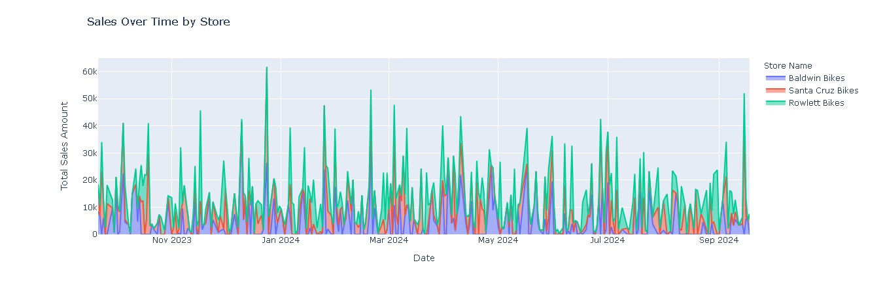
Examples for visualization

Slide 53
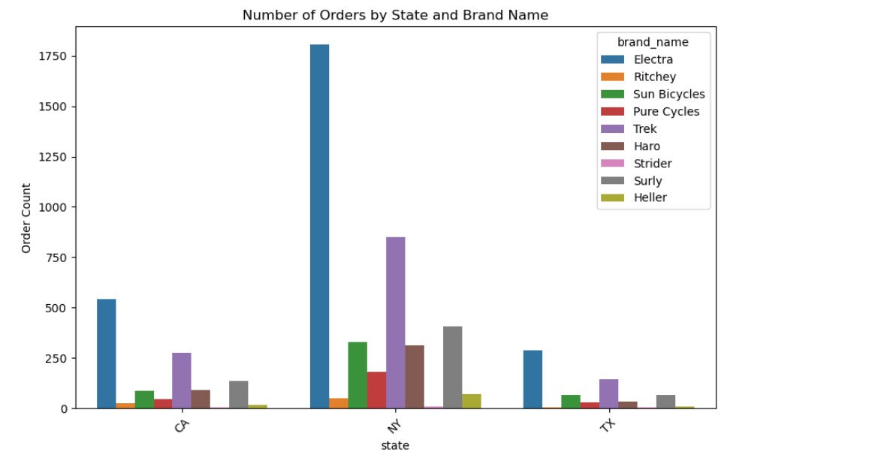
Examples for visualization

Slide 54
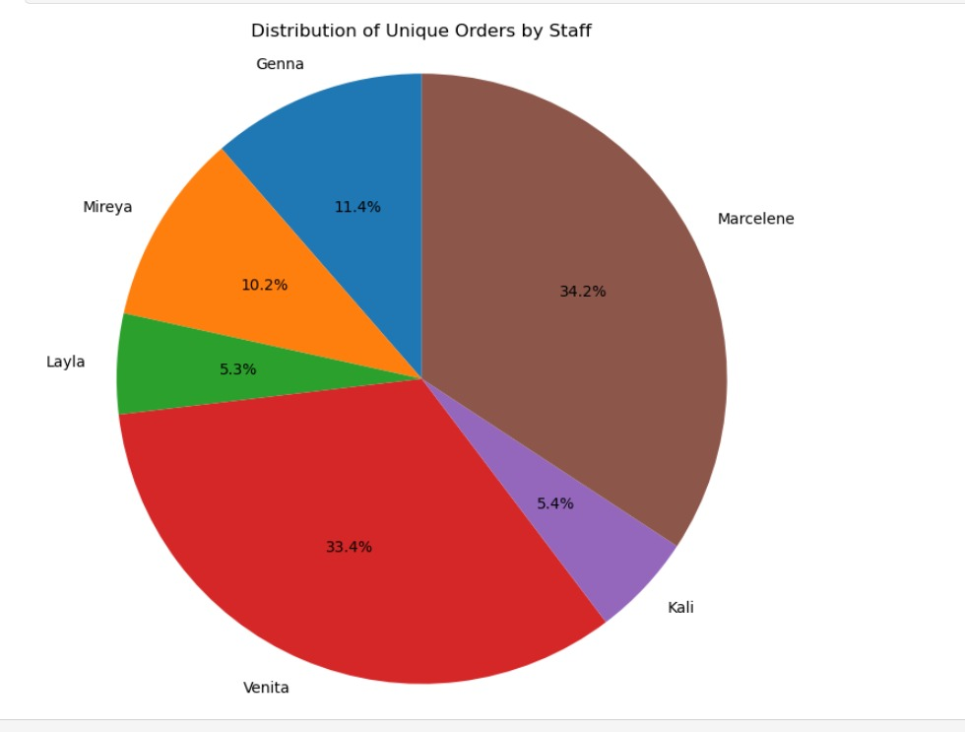
Examples for visualization

Slide 55
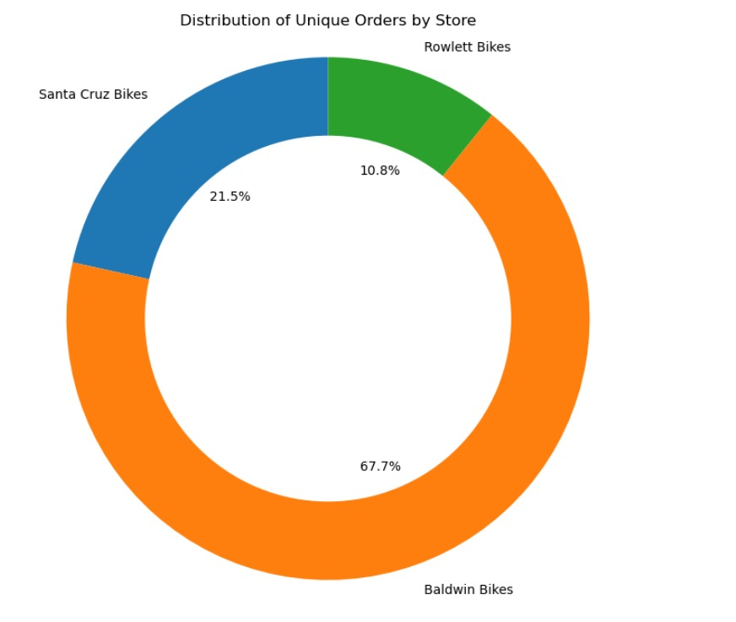
Examples for visualization

Slide 56

Examples for visualization

Slide 57
secondly
Model
building

Slide 58

Important libraries & loading the data (table reading)

Slide 59

Merging specific data

Slide 60

Creating new features

Slide 61
Calculating relation time

Slide 62
Removing empty values

Slide 63
Splitting the data into train and test
Train : 80%
Test : 20%

Slide 64



Creating Vector assembler , Randomforest , Grid search , Cross-Validation

Slide 65

Model Training & Prediction

Slide 66

Model Evaluation

Slide 67

Results

Slide 68


Slide 69


Prediction according to input

Slide 70

Prediction according to input

